Slide 1
Globosales case
By devoteam
Analyst: Stephany Rojas Gerena

Slide 2
Content
Understanding Globosales business
Analyzing sales distribution
Checking stationarity
Split the data
Fitting ARIMA model
Prediction with ARIMA model
Performance evaluation
Final recommendations

Slide 3
Globosales business model
Globosales platform
Increase revenue = increase e-stores transactions
E-stores retention= increase e-stores sales
We want to build a model to predict sales
E-stores
Customers

Slide 4
Sales distribution
Sales distribution per Country:
Sales distribution per e-store:
→ 80% of the sales are originated in 4 countries
→ Sales are equally distributed among stores

Slide 5
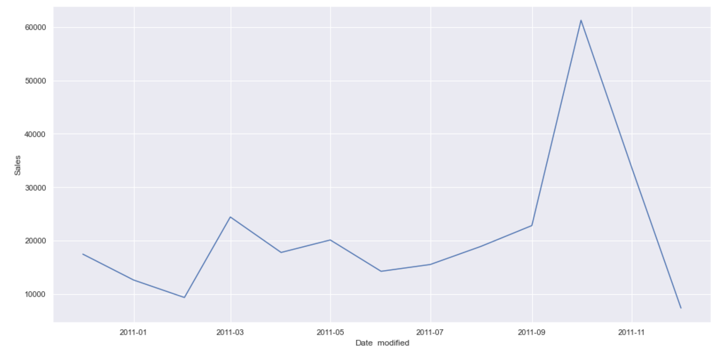
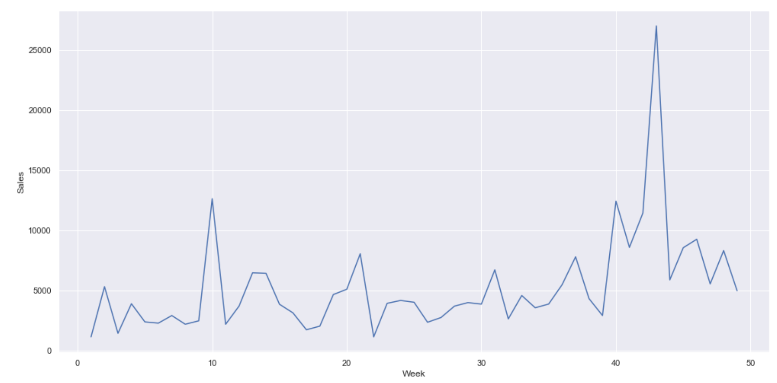
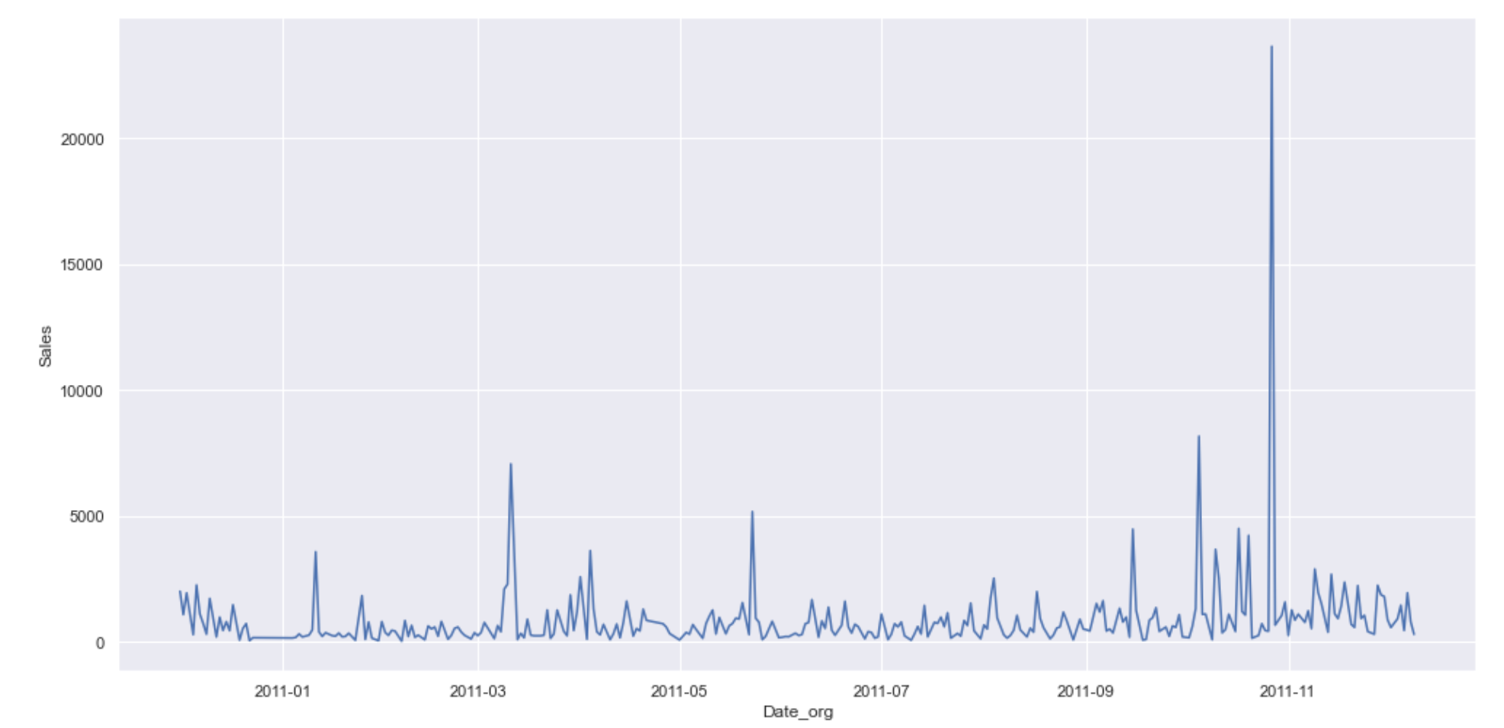
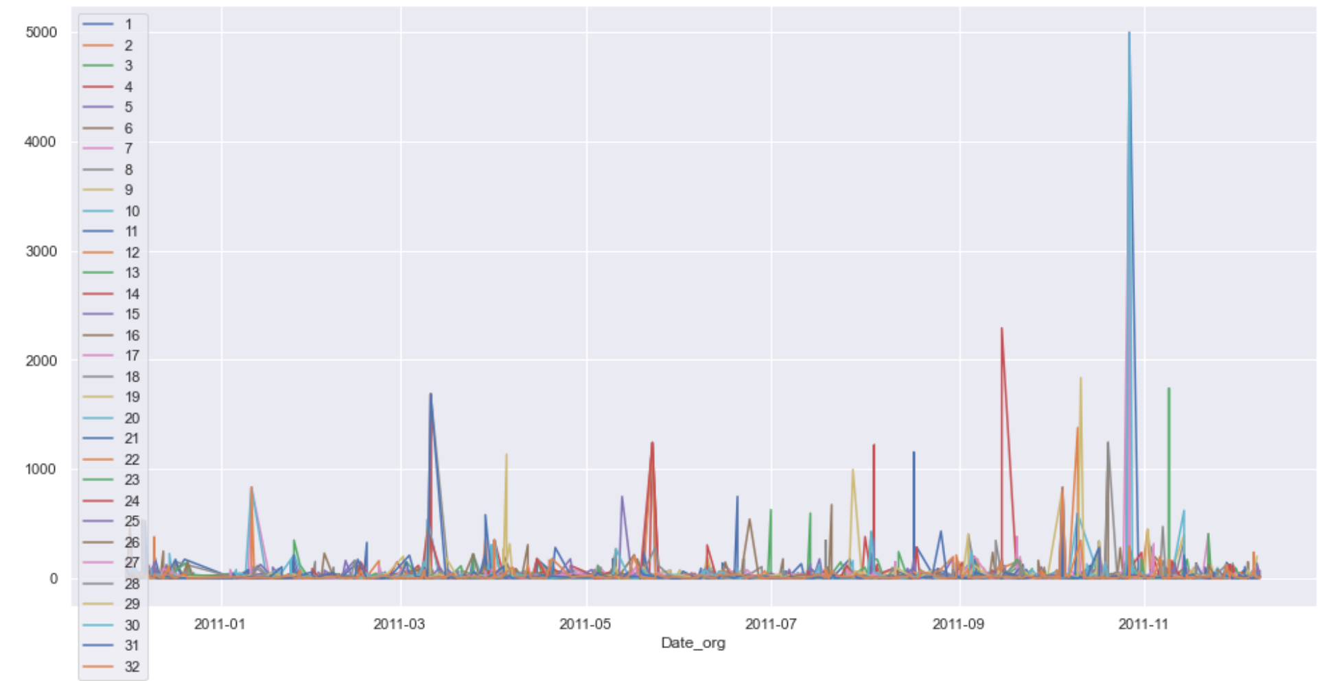
Checking for stationarity
monthly:
weekly:
Graphically it seems that there is a season in the last months of the year
Seasons may vary per e-store (worth including in further analysis)
There might be a season per day of week (worth including in further analysis)
daily:
per e-store:

Slide 6
Checking for stationarity
A more formal check using the Dickey-fuller test:
H0: non-stationary time series
H1: stationary time series
α=0.05 p-value=8.16 e-16
p-value< α : Reject null hypothesis
We reject the null hypothesis, meaning that the time series is stationary
The apparent season effect in the plots is not strong enough for being non-stationary
However, we don’t have enough data to guarantee this conclusion

Slide 7
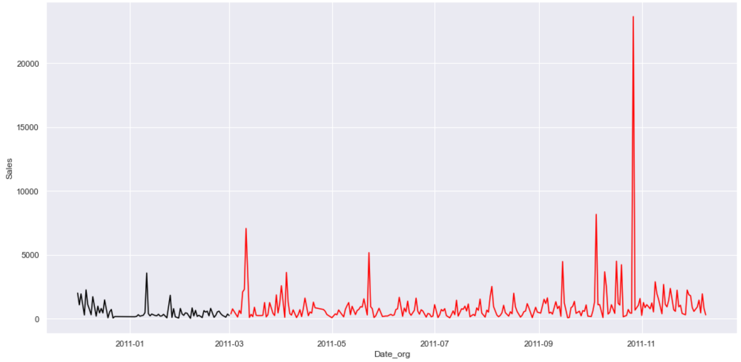
Splitting data for training and testing
We will split the data such that everything before March 2011 will serve as test data, all other dates will be used as training data
Since our data set is small, we will use 80% of the data as training data
Data test
Data train

Slide 8
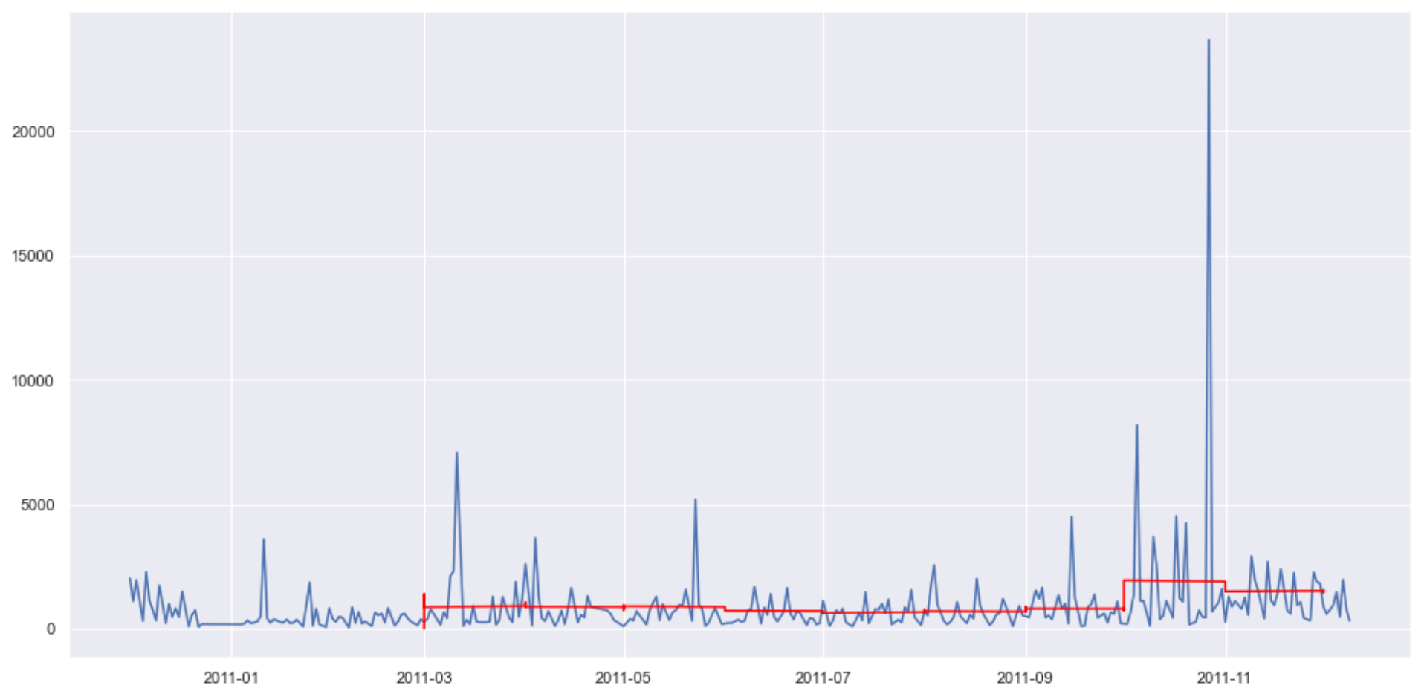
Fitting ARIMA Model
We will use the Autoregressive Integrated Moving Average (ARIMA) model which combines both Autoregression (AR) and Moving Average (MA) models as well as a differencing pre-processing step of the sequence to make the sequence stationary, called integration (I).
Sales
Original data
Fitted model

Slide 9
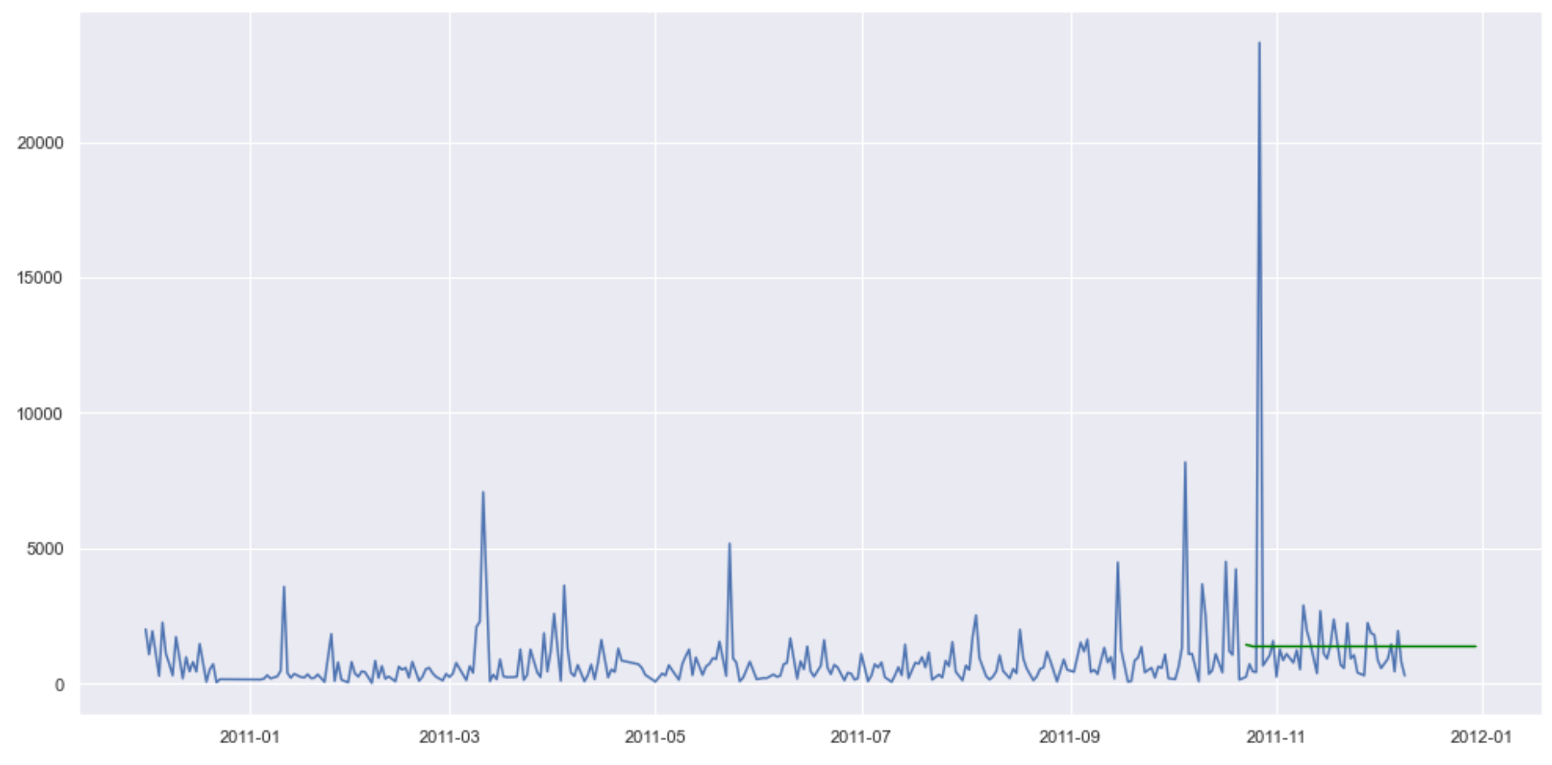
Sales forecast using arima model
Prediction of sales using the fitted model
Sales
Original data
Prediction

Slide 10
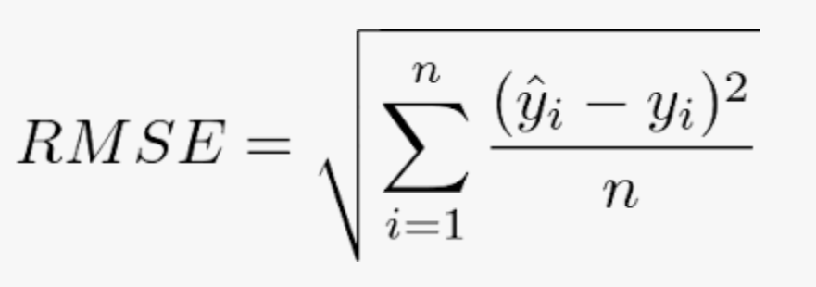
Evaluating performance
We will use the root mean squared error to evaluate the performance
= 1015.5
The error is high → can be improved choosing more optimal tunning parameters
=

Slide 11
Recommendations
Collect more historical data to have a better prediction
Focus on the sales in the countries that have the highest impact
Analyze the peak in November 2011: was there any special event? is it an outlier?
Choose the tuning parameters using grid search to have a better model

